Slide 1
PSCS_46_Application for Assessment of Quality of Textbook/ Reference Books/E-Books
CSE7101- Capstone Project
Review-1
Batch Number : CSE_23
Under the Supervision of,
Dr./Mr./Ms./Prof. Ms.Kummara Sruthi &
Ms.Shweta Singh
Professor / Associate Professor / Assistant Professor
School of Computer Science and Engineering
Presidency University
20221CSE0234 | Syed Thousif
20221CSE0213 | Patil Jashwanth Reddy
20221CSE0211 | Kambam Nithin Kumar Reddy
Roll Number | Student Name
Name of the Program : School of Computer Science & Engineering
Name of the HoD : Dr. Asif Mohammed
Name of the Program Project Coordinator : Dr.Jayavadivel Ravi , Mr. Muthuraju V
Name of the School Project Coordinators : Dr.Sampath A K , Dr. Geetha A

Slide 2
Problem Statement Number : PSCS_46
Organization: Ministry Of AYUSH
Category (Hardware / Software / Both) : Software
Problem Description : The medical students aiming to be good physicians, need to select a standard medical textbook. It is evident that there are several books made available in ASU (Ayurveda, Unani, Siddha) medical systems and every book claims that the book has been written as per CCIM or NCISM syllabus. Amongst some are good and some are of poor quality and were written with vested interest. Due to this, students are trapped by substandard books that leads to poor quality standard among students. Identifying this issue and its impact on medical on the medical system, NCISM constituted an expert committee for the development of an assessment scale for textbooks/ reference books. The expert committee after thorough deliberations developed the assessment scale for the quality assessment of textbooks/ reference books. This assessment scale serves the purpose of:- Selection of quality textbooks by teachers for their students. Serving as a reference for textbook writers. Providing criteria to recommend for inclusion in the list of recommended apex/ regulatory bodies. The assessment process requires a review of the books by reviewers (subject-wise reviewers located across the country, 3 reviewers per book) and summarizing the reviewer's remarks and decision by the committee. The development of an application on this will help to get reviews from people around the world online and also will help to summarize all the reviewed data in a faster mode.:

Slide 3
Content
Problem Statement
Objectives
Background and Related work for title Selection
Analysis of Problem Statement
Innovation or Novel Contributions
Git-hub Link
Timeline of the Project
References

Slide 4
Problem Statement : How it Works
Process for Assessment of Quality of Textbook / Reference Books / E-Book
Application Submission – Author or publisher submits details of the book.
Sample & Documents – Provide copy/link, author details, and syllabus relevance.
Expert Review – Panel evaluates content accuracy, relevance, and clarity.
Feedback – Suggestions or corrections if needed.
Approval – Certified and added to recommended reading list.

Slide 5
Steps Requirement
Technology Stack Components:
1. Frontend (User Interface)
Framework: React.js or Angular , Styling: Bootstrap
2. Backend (Application Logic)
Language & Framework: Node.js
3. Database (Data Storage)
NoSQL : MongoDB
4. Deployment & Hosting
Cloud: AWS / Azure / Google Cloud
CI/CD: GitHub Actions
5. Additional Tools
Version Control: Git & GitHub
Testing: Jest / Mocha / Selenium

Slide 6
Github Link
The Github link provided should have public access permission.
Github Link
https://github.com/SThousif/Application-for-Assessment-of-Quality-of-Textbook-Reference-Books-E-Books-

Slide 7
Analysis of Problem Statement (contd...)
Software and Hardware Requirements:
Software Requirements | Hardware Requirements
Windows 10/11, macOS, or Linux | Processor: Intel i5 / AMD Ryzen 5 or higher
React.js / Angular, HTML5, CSS3, JavaScript | RAM: 8 GB (16 GB recommended)
Node.js with Express.js or Python Django/Flask | Storage: 256 GB SSD (512 GB recommended)
MySQL / PostgreSQL, MongoDB | Graphics: Integrated or dedicated GPU
AWS / Azure / Google Cloud hosting | Internet: Broadband min 2MBPS

Slide 8
Analysis of Problem Statement (contd...)
Current Issue:
Manual evaluation is time-consuming, inconsistent, and lacks standardization.
Feedback is stored in scattered formats with no easy way to track or compare.
No automation for calculating scores or generating reports.
Decision-making is delayed due to lack of real-time data.
Impact:
Poor quality or outdated materials may be approved.
Administrative burden on faculty and staff.
Limited transparency and accountability.
Need:
A centralized, automated, and data-driven system for quality assessment.

Slide 9
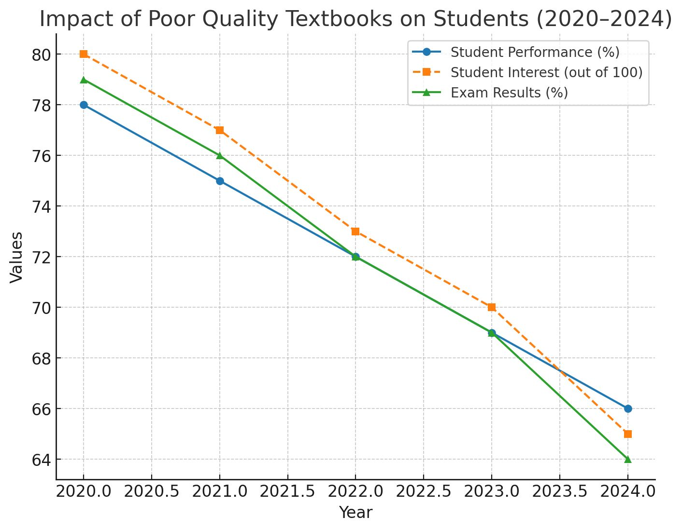
Analysis Through Line Chart ✅

Slide 10
Timeline of the Project (Gantt Chart)
Phase | Week 1 | Week 2 | Week 3 | Week 4 | Week 5 | Week 6 | Week 7 | Week 8
1. Requirement Gathering & Analysis | ██████ | ██████
2. Design (UI/UX & Architecture) |  | ██████ | ██████
3. Development (Frontend & Backend) |  |  | ██████ | ██████ | ██████
4. Testing & Debugging |  |  |  |  | ██████ | ██████
5. Deployment & Documentation |  |  |  |  |  |  | ██████ | ██████

Slide 11
References (IEEE Paper format)
[1] Application for Assessment of Quality of Textbook/Reference Book/E-Books, International Journal of Engineering Innovations and Management Strategies, published circa early 2025 (about six months ago) IJEIMS.
[2] Q. Zhou, “Evaluating book impacts via integrating multi-source reviews,” Scientometrics, vol. 129, 2024
[3] R. K. Singh and A. Sharma, "Design and development of web-based evaluation system for academic resources," International Journal of Computer Applications, vol. 183, no. 8, pp. 25–30, June 2021.
[4] S. R. K. Somasekhar, P. V. Kumar, and R. J. Reddy, "Automated assessment of educational content using multi-criteria analysis," in Proc. IEEE International Conf. on Technology for Education (T4E), Mumbai, India, 2020, pp. 215–220.
[5] M. A. Al-Emran, "Towards an intelligent framework for textbook evaluation in higher education," Education and Information Technologies, vol. 24, no. 2, pp. 1453–1468, Mar. 2019.
[6] N. G. T. Izquierdo, L. A. G. Villalobos, and J. D. M. Ramírez, "A framework for the evaluation of e-learning materials," in Proc. IEEE Global Engineering Education Conf. (EDUCON), Abu Dhabi, UAE, 2016, pp. 1129–1134.
[7] T. M. Connolly and E. A. Stansfield, "Evaluating the quality of learning resources: A web-based approach," in Proc. IEEE International Conf. on Advanced Learning Technologies (ICALT), Athens, Greece, 2014, pp. 37–41.

Slide 12


